Slide 1
WSLab Datacenter Simulation - Scripts
Jaromir Kaspar
Sr. Premier Field Engineer, Microsoft
aka.ms/wslab
@jaromirkaspar

Slide 2

About me
Almost 8 years in Microsoft
Main focus: AzSHCI
Main skills: Windows Server, PowerShell

Slide 3
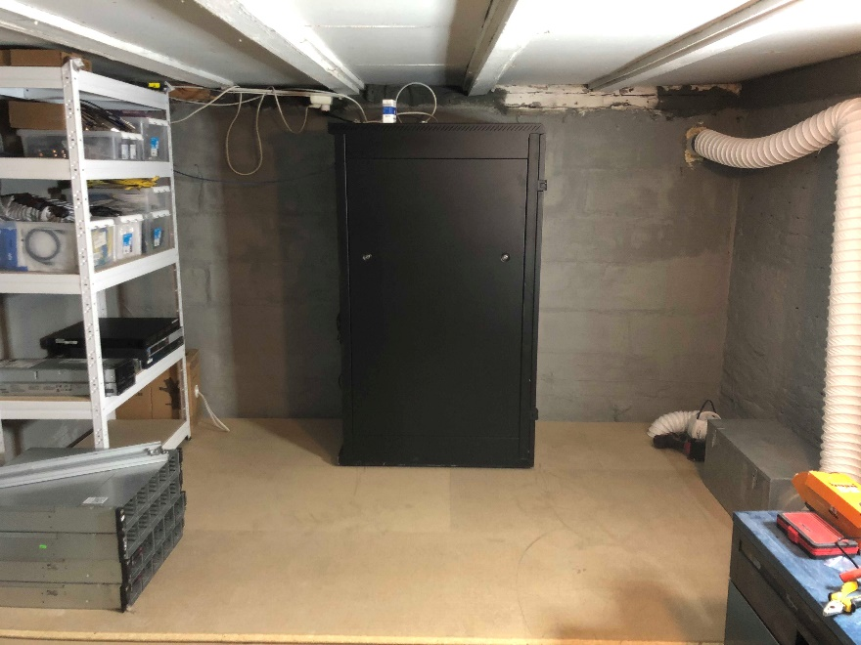
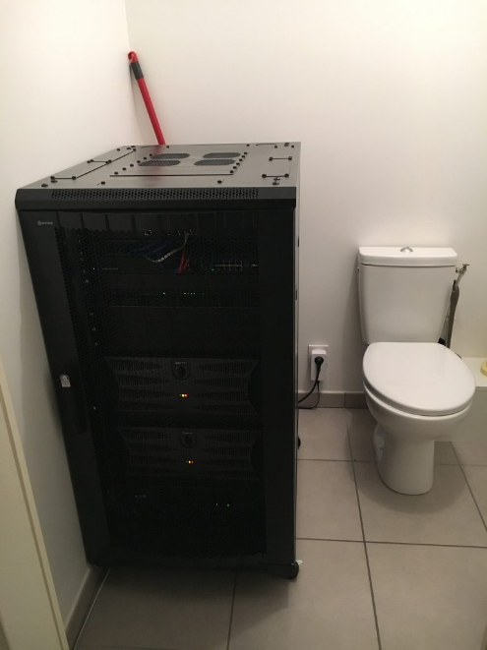
Typical Lab environments
Jan-Tore Pedersen
heated basement
Romain Serre
heated bathroom

Slide 4
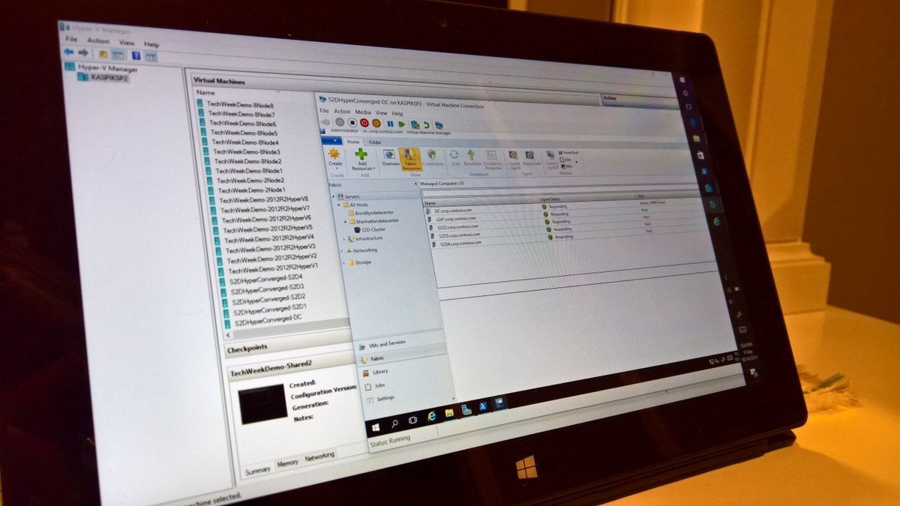
WSLab

Slide 5
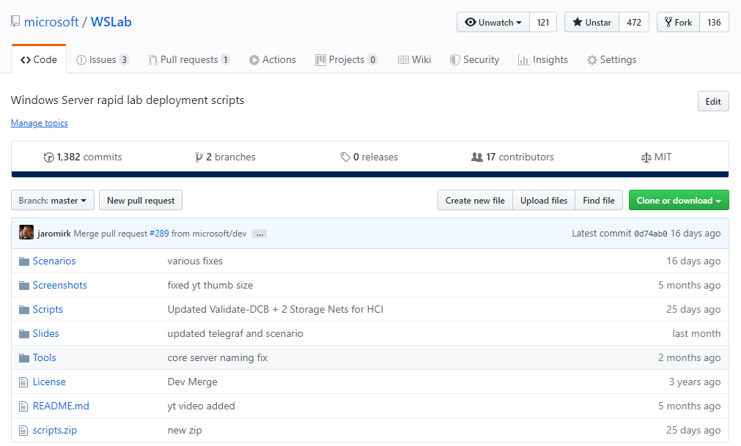
WSLab
All slides/scripts are already available under slides on GitHub!
http://aka.ms/wslab
http://aka.ms/wslab

Slide 6
WSLab principles
Small
All disks are differencing (parent is in ParentDisks folder)
Fast
DC is just imported. All changes go to diff disk (checkpoint)
Simple
Result is 3 scripts (LabConfig, Deploy, Cleanup)

Slide 7
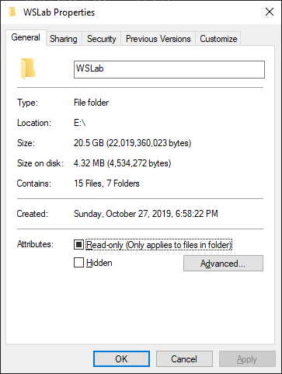
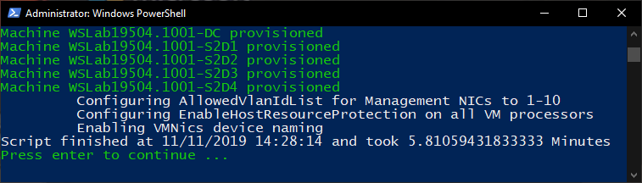
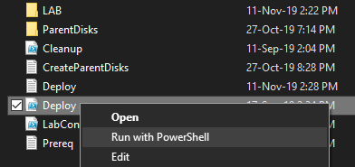
WSLab principles
Small
Around 20 GB before deploy
Around 30 GB with 4 S2D servers running
Fast
Deploy is ~5 minutes
Simple
Right-click, run with PowerShell

Slide 8
Demo – Working with scripts

Slide 9
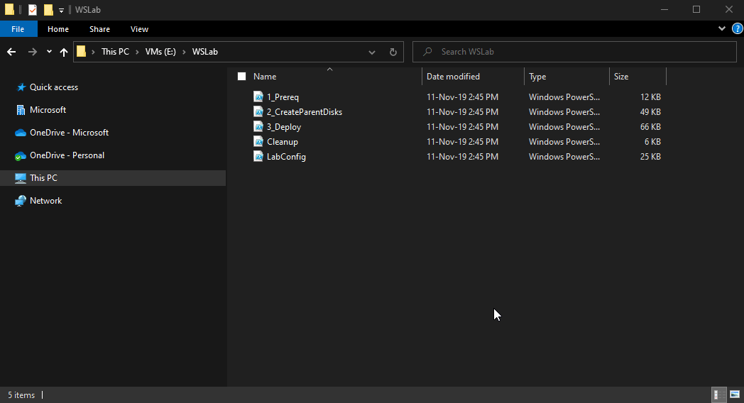
First script – 1_Prereq.ps1
Creates folder structure
Downloads DSC modules (required for DC hydration)
Downloads vmfleet and diskspd
Creates helper scripts (for SCVMM deployment, additional parent disks creation, …)

Slide 10
1_Prereq.ps1 tips
Offline environment
Run script first on Internet connected machine, copy all and then run again on offline machine
If SCVMM/SQL is deployed, don’t change password/domain in labconfig between first and second scripts (password of service account is injected to script)

Slide 11
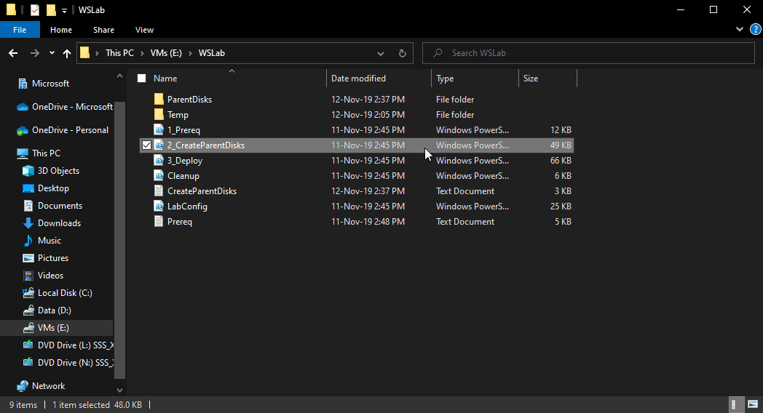
Second script – 2_CreateParentDisks.ps1
Will check if Hyper-V is installed
Let you choose Server image (2016, 2019 or Insider)
Creates parent disks (tools.vhdx, Full and Core Windows Server)
Creates Domain Controller (PowerShell DSC)
At the end wipes first and second script (if requested) as it’s no longer needed

Slide 12
2_CreateParentDisks.ps1 - tips
If parent disks exists, it’s creation will be skipped (just DC is hydrated)
If running on server core, you can point script to ISO and MSU files (labconfig.ps1)
Disabling AMSI (Anti-Malware Scanning Interface) reduces script run time to half
Before running 2_CreateParentDisks you can change labconfig with domain name, user password, DHCP scope…

Slide 13
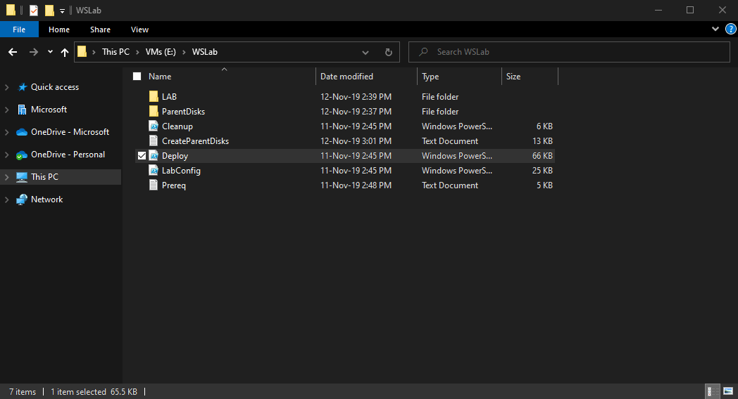
Third script – Deploy.ps1
Deploy VMs as defined in LabConfig
Check if system is capable (like if shared disks are working, vTPM can run if used…)
Imports DC, creates snapshot, connects to internet, create NAT (in DC)
Create VMs – all differencing, mount VHD, djoin…

Slide 14
Deploy.ps1-tips
Can expand lab (if VM exists, it will skip it)
Can connect lab to internet (if internet was $false before)
Automatically turns on DC if was shut down
Mounts svhdxflt if shared VHDs are in configuration (for hyper-v guest clusters)

Slide 15
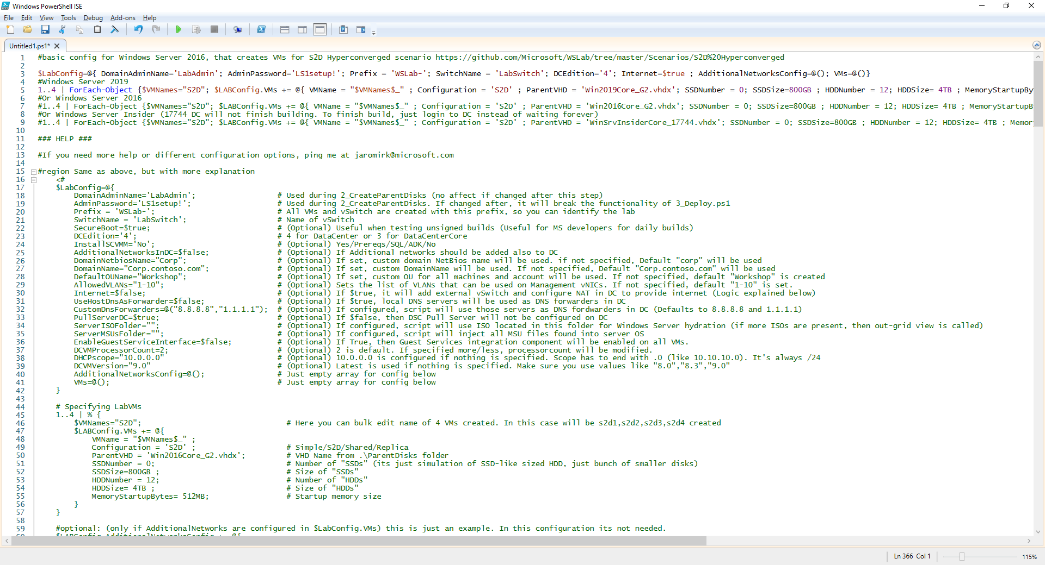
LabConfig.ps1

Slide 16
LabConfig.ps1

Slide 17
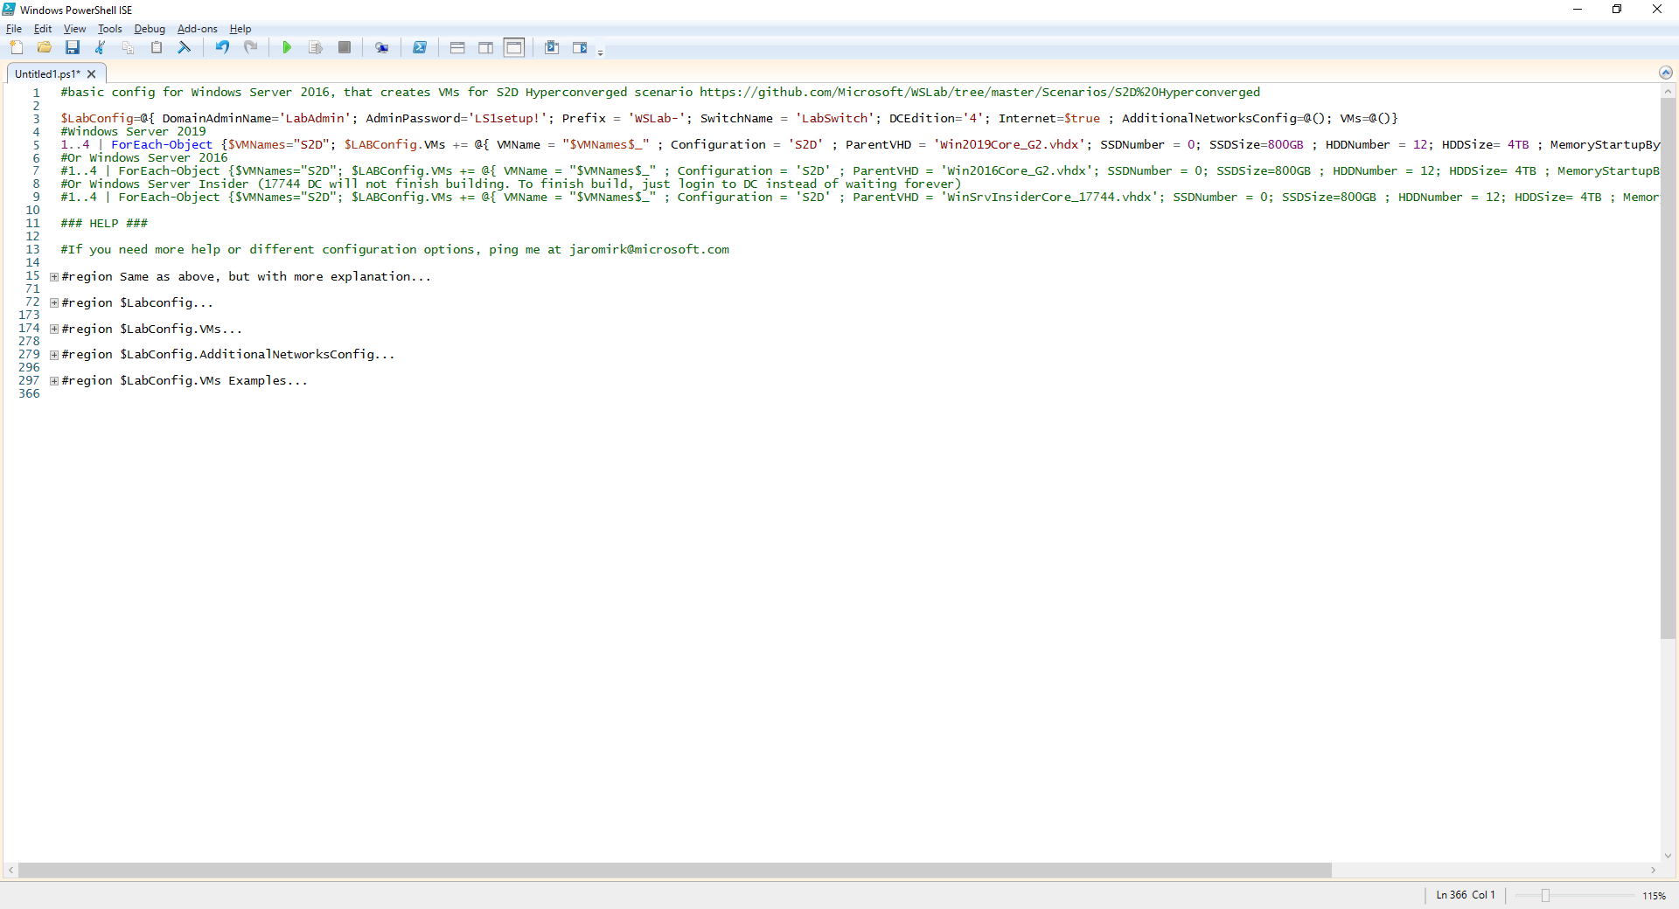
LabConfig.ps1
Ctrl+m

Slide 18
LabConfig.ps1
Don’t change this after 2_CreateParentDisks.ps1

Slide 19
LabConfig.ps1

Slide 20
LabConfig.ps1

Slide 21
LabConfig.ps1

Slide 22
LabConfig.ps1

Slide 23
LabConfig.ps1 Deep dive

Slide 24
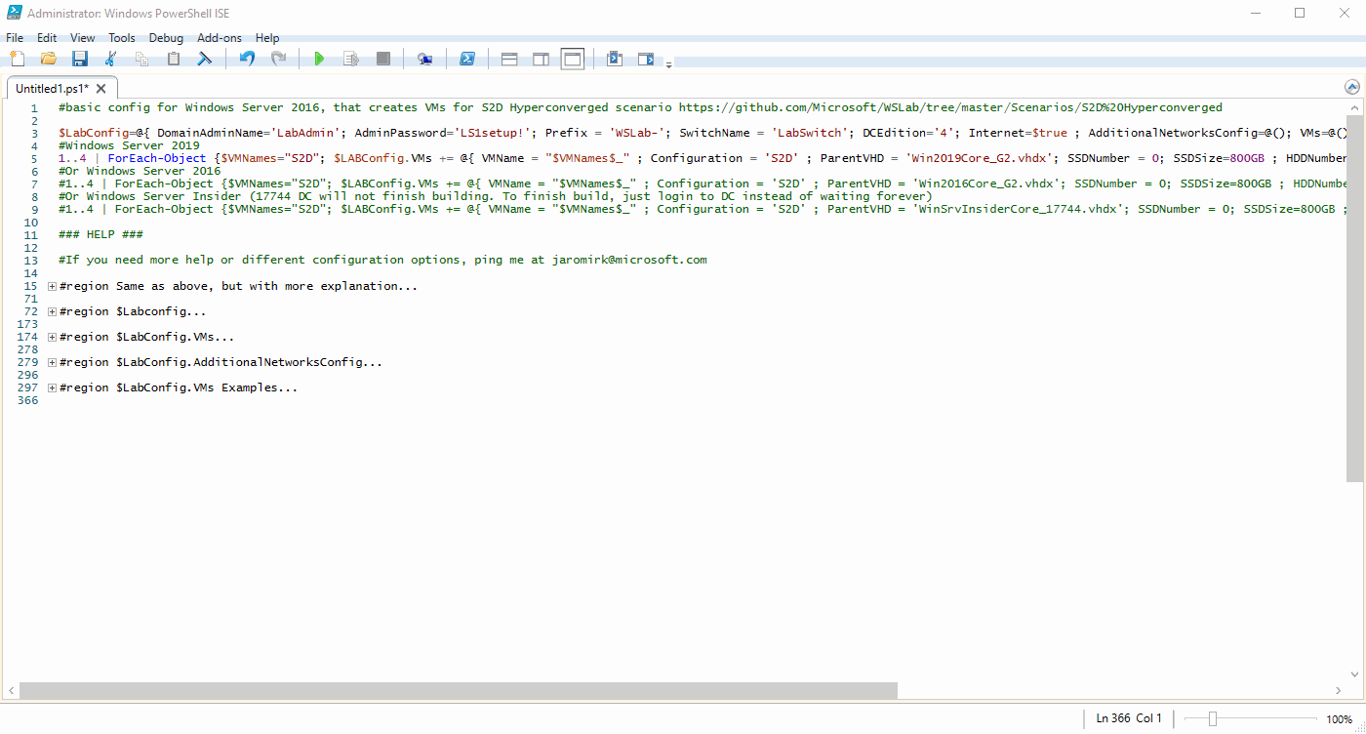
LabConfig.ps1 - Advanced

Slide 25
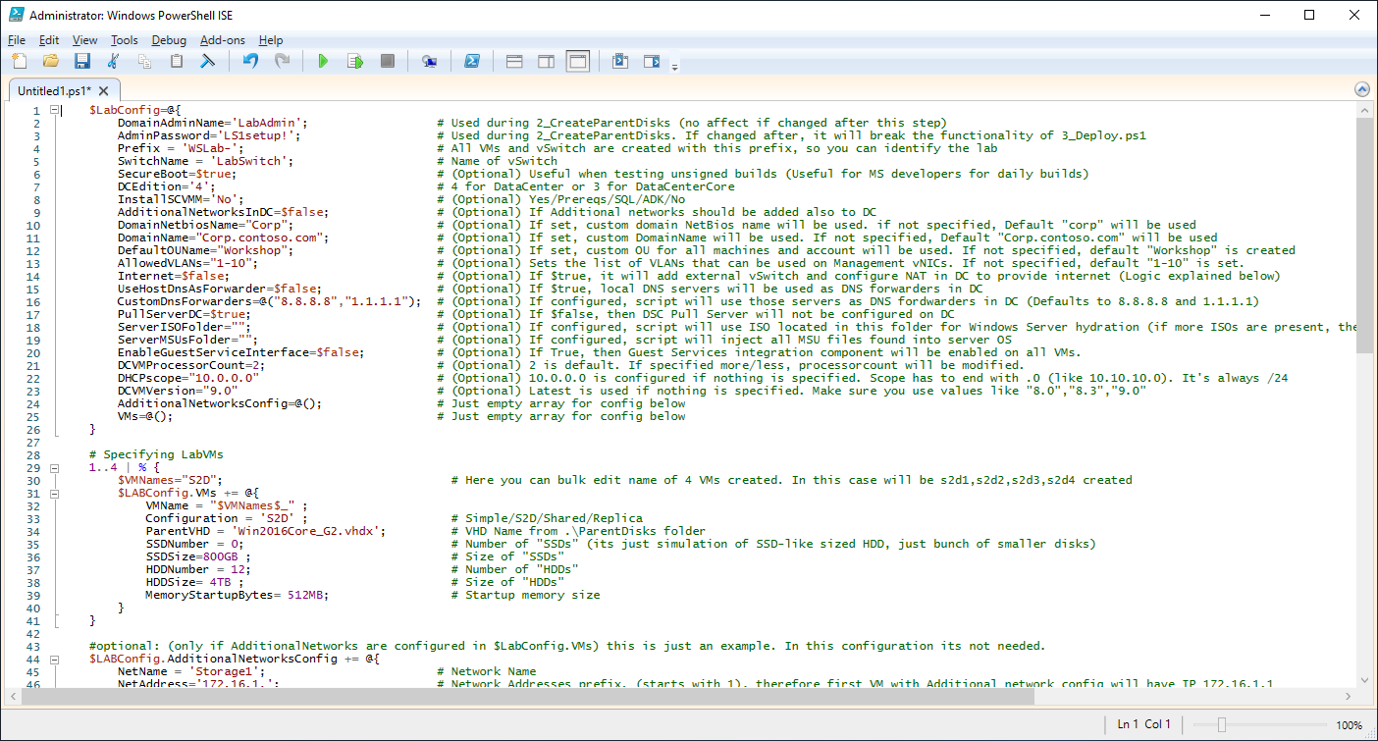
LabConfig.ps1 - Advanced

Slide 26
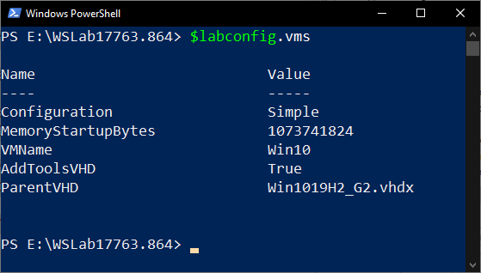
$Labconfig.VMs (simple)
$LABConfig.VMs += @{
VMName = 'Win10' ;
Configuration = 'Simple' ;
ParentVHD = 'Win1019H2_G2.vhdx' ;
MemoryStartupBytes= 1GB ;
AddToolsVHD=$True
}

Slide 27
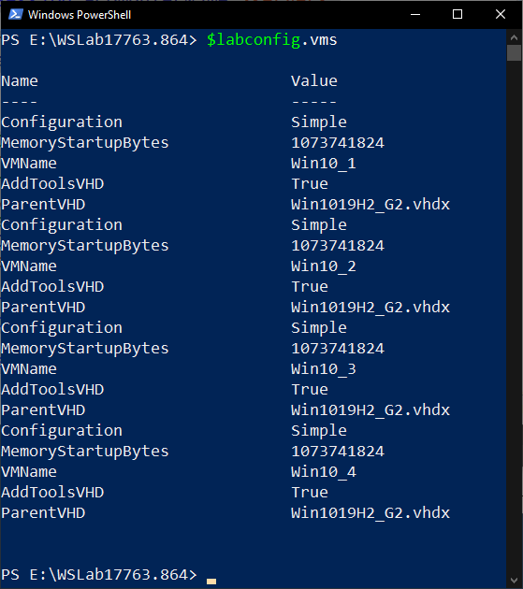
$Labconfig.VMs (simple) – cont.
1..4 | % {
$VMNames="Win10_" ;
$LABConfig.VMs += @{
VMName = "$VMNames$_" ;
Configuration = 'Simple' ;
ParentVHD = 'Win1019H2_G2.vhdx' ;
MemoryStartupBytes= 1GB ;
AddToolsVHD=$True
}
}

Slide 28
$Labconfig.VMs (S2D)
1..4 | % { $VMNames= "S2D" ; $LABConfig.VMs += @{ VMName = "$VMNames$_" ; Configuration = 'S2D' ; ParentVHD = 'Win2019Core_G2.vhdx' ; SSDNumber = 4; SSDSize=800GB ; HDDNumber = 12 ; HDDSize= 4TB ; MemoryStartupBytes= 512MB } }

Slide 29
$Labconfig.VMs (Shared) – (Shared Spaces)
1..2 | % { $VMNames="Shared" ; $LABConfig.VMs += @{ VMName = "$VMNames$_" ; Configuration = 'Shared' ; ParentVHD = 'Win2012R2Core_G2.vhdx' ; SSDNumber = 3; SSDSize=800GB ; HDDNumber = 9 ; HDDSize= 4TB ; MemoryStartupBytes= 512MB ; VMSet= 'SharedLab1' } }
Shared Storage Spaces are Deprecated now

Slide 30
$Labconfig.VMs (Shared) - (Hyper-V & SAN simulation)
1..4 | % { $VMNames="Shared" ; $LABConfig.VMs += @{ VMName = "$VMNames$_" ; Configuration = 'Shared' ; ParentVHD = 'Win2012R2Core_G2.vhdx' ; SSDNumber = 1; SSDSize=1GB ; HDDNumber = 4 ; HDDSize= 4TB ; MemoryStartupBytes= 512MB ; VMSet= 'SharedLab1' } }
Witness Disk

Slide 31
$Labconfig.VMs (Shared) - (Hyper-V & SAN simulation)
1..4 | % { $VMNames="Shared" ; $LABConfig.VMs += @{ VMName = "$VMNames$_" ; Configuration = 'Shared' ; ParentVHD = 'Win2012R2Core_G2.vhdx' ; SSDNumber = 1; SSDSize=1GB ; HDDNumber = 4 ; HDDSize= 4TB ; MemoryStartupBytes= 512MB ; VMSet= 'SharedLab1' } }
CSVs

Slide 32
$Labconfig.VMs (Replica)
1..2 | % { $VMNames="Replica" ; $LABConfig.VMs += @{ VMName = "$VMNames$_" ; Configuration = 'Replica' ; ParentVHD = 'Win2019Core_G2.vhdx' ; ReplicaHDDSize = 20GB ; ReplicaLogSize = 10GB ; MemoryStartupBytes= 2GB ; VMSet= 'ReplicaSet1' ; AdditionalNetworks = $True} }
3..4 | % { $VMNames="Replica" ; $LABConfig.VMs += @{ VMName = "$VMNames$_" ; Configuration = 'Replica' ; ParentVHD = 'Win2019Core_G2.vhdx' ; ReplicaHDDSize = 20GB ; ReplicaLogSize = 10GB ; MemoryStartupBytes= 2GB ; VMSet= 'ReplicaSet2' ; AdditionalNetworks = $True} }

Slide 33
LabConfig summary
No need to figure out your LabConfig
Examples are inside labconfig.ps1, just copy lines
Every scenario has LabConfig where you can get inspiration from
Should be simple enough (Hashtable vs XML vs JSON)
If you have ideas on how to improve, let me know!

Slide 34
WSLab & SCVMM

Slide 35
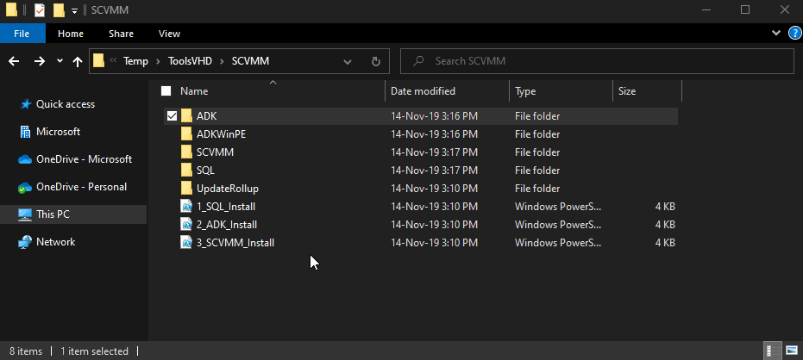
Advanced – create lab with SCVMM
Do this before 2_CreateParentDisks.ps1
Folders needs to be populated with ADK, ADKWinPE, SCVMM and SQL (UR is optional)
Or just copy tools.vhdx with these folders aready populated
In LabConfig add InstallSCVMM='Yes'

Slide 36
Demo – SCVMM

Slide 37
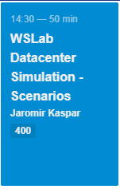
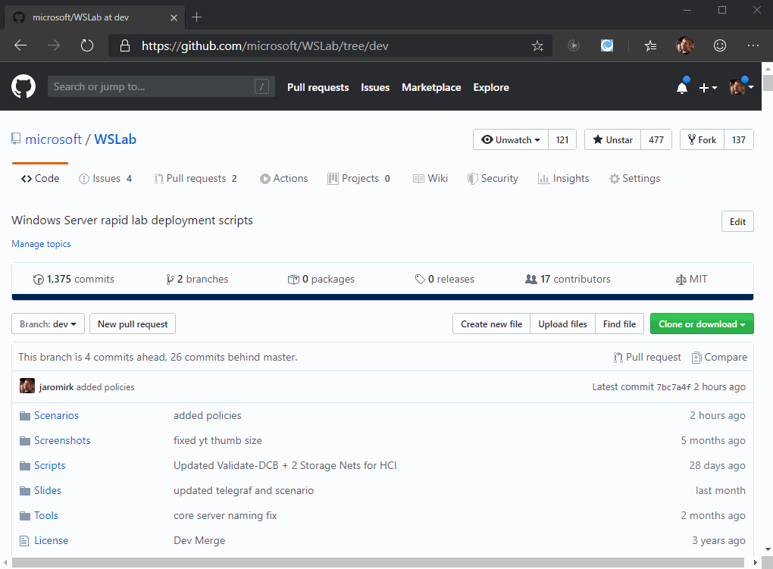
Wrap-up
Be smart – use on your laptop!
You can use for training deliveries – License is MIT
No hardware? – No problem. WSLab runs on Azure too!
Tomorrow: Session about Scenarios – don’t miss it!

Slide 38














Thank you Sponsors!

